Slide 1
Juvenile Diabetes (Type 1)
Debra Edwards
March 13, 2013

Slide 2
What Is Type 1 Diabetes?
Condition previously known as juvenile diabetes since it is primarily found among young kids although the problem is presently known to have been among adults too.
T1D is a condition in which the pancreas produces little or no insulin.
Insulin is a hormone that helps your body use blood sugar. Known as glucose, for energy.
Your body takes the food you eat and breaks down fat protein and carbohydrates for energy.
While your body is digesting the food the carbs are broken down into glucose the glucose is then absorbed into the bloodstream where it is carried to cells throughout your body,

Slide 3
What Is Type 1 Diabetes?
Insulin cells absorbs the glucose in your body allowing it to be used as energy.
A healthy pancreas releases a regular supply of insulin into your blood stream.
When your blood glucose levels rise, your pancreas responds by releasing more insulin.
In a person with T1D they produce little or no insulin causing glucose to remain in the blood stream.

Slide 4
Treatment Options
A person with T1D needs to monitor and maintain healthy blood glucose levels or it can lead to health complications.
If your blood glucose level drops too low even for a short amount of time you may feel dizzy or hot or cold.
If it drops extremely low you may loose consciousness.
By taking insulin you can keep your blood glucose within a healthy range.
Not a cure

Slide 5
Implications:
Diabetes occurs in individuals of any age.
More than 13,000 kids in the US have T1D
Its among the most common long-term diseases in school aged children, type 2 is not.
Genetic factors can influence the possibility of getting T1D
Unknown factors that trigger the onset of the disease.
Environmental factors can also be the cause of the rise of early symptoms.
*Lifestyle factors are not implicated for Type 1 Diabetes.

Slide 6
Physical activity is a vital aspect for children because it lowers blood glucose, but remember to make sure a doctor had been consulted on the child with T1D exercise program.
There can be dangerous effects from skipping meals.
Myth: People with diabetes can’t eat sweets.
If eaten as part of a healthy diet combined with exercise it is fine for all people equally. Health meals are the same for all people, including diabetics.
It is important to balance blood sugar levels to control diabetes since lower sugar levels display health risks
.

Slide 7
Characteristics
Some early warning signs that someone may need to get tested for diabetes are: · Extreme thirst
· Frequent urination
· Sudden vision changes, blurred vision
· Increased appetite, constant hunger
· Sudden weight loss
· Heavy, labored breathing

Slide 8
Diabetes in the School
School Responsibilities Under Federal Law

Slide 9
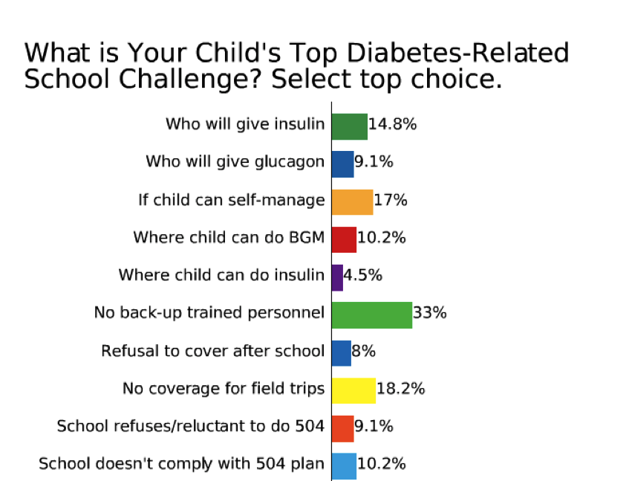
Notes:
When parents were asked to name their child’s top diabetes related school challenge, they selected “No back-up trained personnel,” the most often. Important to communicate and advocate for this.

Slide 10
Section 504 Requirements
To be protected by ADA/504 the student must have a disability defined as:
This includes diabetes
Substantial Limitation of Major Life Activities (ADA / 504)
Endocrine function
Caring for one's self
Performing manual tasks
Eating
Notes:
.

Slide 11
Americans with Disabilities Act (ADA)
Establishing Eligibility
Note from clinician stating disability and limitations,
Explain other major life activities that are limited when your child is experiencing hypo- or hyperglycemia
Notes:
Schools must make reasonable changes to afford equal opportunity, unless doing so imposes an undue burden.

Slide 12
Eligibility for IDEA "Special Education”
Another disability other than diabetes that limits learning/academic progress
or
Frequent swings in blood glucose that adversely impacts learning.
Diabetes Medical Management Plan
Individualized Health Care Plan
Emergency Care Plans for Hypoglycemia and Hyperglycemia
Notes:
Family Educational Rights and Privacy Act

Slide 13
Caring for Childhood Diabetes (T1D) in School
If determined to have a disability, under the school districts disability proceedures in order to participate in regular school activities. (Inc. extracurricular)
Everyone has a role to play in effective diabetes management in the school setting:
School nurse
Teachers
Administrators
School health team
Students, parents, and families

Slide 14
Educational Implications Diabetes Management Team
To ensure that students with diabetes are ready to learn & have equal access to all educational opportunities
To minimize the possibility that diabetes-related emergencies will disrupt classroom activities
Maintaining optimal blood glucose control (Monitoring & administration) in a medically safe environment.
Recognizing and treating hypoglycemia and hyperglycemia
Responding to psychosocial issues
. Children with diabetes often experience emotional effects due to being ‘different’ from classmates and friends
.
Notes:
Dealing with childhood diabetes is difficult because controlling the disease requires following a grueling regimen with strict vigilance – something most children don’t enjoy. In addition to the physical ramifications of the disease,

Slide 15
http://www.youtube.com/embed/aoD2lklbS4U?feature=player_detailpage
</iframe="640" height="360" src="http://www.youtube.com/embed/aoD2lklbS4U?feature=player_detailpage" frameborder="0" allowfullscreen></iframe>

Slide 16
References
National Diabetes Education Program. (2010 June). Helping the Student with Diabetes Succeed. Retrieved from http://ndep.nih.gov/hcp-businesses-and-schools/Schools.aspx
Section 504 of the Rehabilitation Act of 1973, as amended, 29 U.S.C. 794, implementing regulations at 34 CFR Part 104. http://www2.ed.gov/policy/rights/reg/ocr/edlite-34cfr104.html
Title II of the Americans with Disabilities Act of 1990, as amended, 42 U.S.C. 12134 et seq., implementing regulations at 28 CFR Part 35. http://www2.ed.gov/policy/rights/reg/ocr/edlite-28cfr35.html
The Americans with Disabilities Act Amendments Act of 2008. http://frwebgate.access.gpo.gov/cgi-bin/getdoc.cgi?dbname=110_cong_ bills&docid=f:s3406enr.txt.pdf
Individual with Disabilities Education Act, 20 U.S.C. 1400 et seq., implementing regulations at 34 CFR Part 300. http://www2.ed.gov/about/offices/list/osers/osep/index.html

